Slide 1
Orientation on the Guidelines for the Grant of FY 2019 PBB
27 September 2019
GT-Toyota Asian Cultural Center, Magsaysay Avenue
cor. Katipunan Ave., University of the Philippines,
Diliman, Quezon City

Slide 2
Hello, PBB Focal Persons! kindly be reminded of the ff:
Eating and drinking inside the hall are not allowed. You may get your PM Snacks outside the hall.
Please do not leave your things unattended.
Connect to our Wifi (GT-Toyota Asian Center)
password: kapayapaan
Thank you ☺

Slide 3
PBB Focal Persons
Notes:
Emcee to welcome agencies and acknowledge VIPs (if there are any).
Acknowledge TWG members and Validating Agencies.

Slide 4
We want your feedback…
Please do not forget to answer the FY 2019 PBB Evaluation online survey. You may access this link thru your laptops, tablets, and/or mobile phones:
http://bit.ly/FY2018PBBEvaluation
Notes:
Emcee may read feedback thru the dashboard of results (for discussion).

Slide 5
Programme
Introduction
Sharing activity
Status of FY 2018
FY 2019 PBB Guidelines
Reminders
Open forum

Slide 6
Share your insights…
Share your experiences in facilitating the streamlining and process improvements within your agencies.
What are your challenges in facilitating this?
Notes:
Questions will change during SUCs session.
Call Ms. Cherry Berris of Tariff Commission – will share short presentation of how they conducted/implemented PBB in their organization.

Slide 7
Share your insights…
Share your experiences in facilitating the PBB within your agencies.
What are your challenges in facilitating this?
Notes:
Questions will change during SUCs session.
Call Ms. Cherry Berris of Tariff Commission – will share short presentation of how they conducted/implemented PBB in their organization.

Slide 8
Policy issuances on performance incentives
FY 2011 – Administrative Order (AO) No. 25 s. 2011
FY 2012 – Executive Order (EO) No. 80 s. 2012
MC No. 2012-01
MC No. 2012-02, MC No. 2012-02A
MC No. 2012-03
MC No. 2012-04
MC No. 2012-05
CHED Memo Order No. 35 s. 2012
GCG MC No. 2012-11, MC No. 2012-14
FY 2013 – MC No. 2013-01, MC No. 2013-01A
GCG MC No. 2013-05, MC No. 2013-06
FY 2014 – MC No. 2014-01
MC No. 2014-03
DBM-LWUA JMC No. 2014-02
GCG MC No. 2014-05 and -06
FY 2015 – MC No. 2015-01
DBM-LWUA JMC No. 13.15
GCG MC No. 2015-05 and -06
FY 2016 – MC No. 2016-01
MC No. 2016-02
GQMC MC No. 2016-1
CSC MC No. 14 s. 2016
FY 2017 – MC No. 2017-01
MC No. 2017-02
DBM-LWUA JMC No. 2017-014-17
DBM-DILG JMC No. 2017-04
GCG MC No. 2017-01
CSC MC No. 14 s. 2017
FY 2018 – MC No. 2018-01
GCG MC No. 2019-01
DBM-LWUA JMC No. 2018-01
DBM-DILG JMC No. 2018-01
FY 2019 – MC No. 2019-01
GCG MC No. 2019-02
Notes:
Here’s the list of the policy issuances the Task Force has released since FY 2012.
For FY 2019, we already have issued MC No. 2019-01 for NGAs and SUCs.
The GCG also released MC No. 2019-02 for GOCCs under GCG.

Slide 9
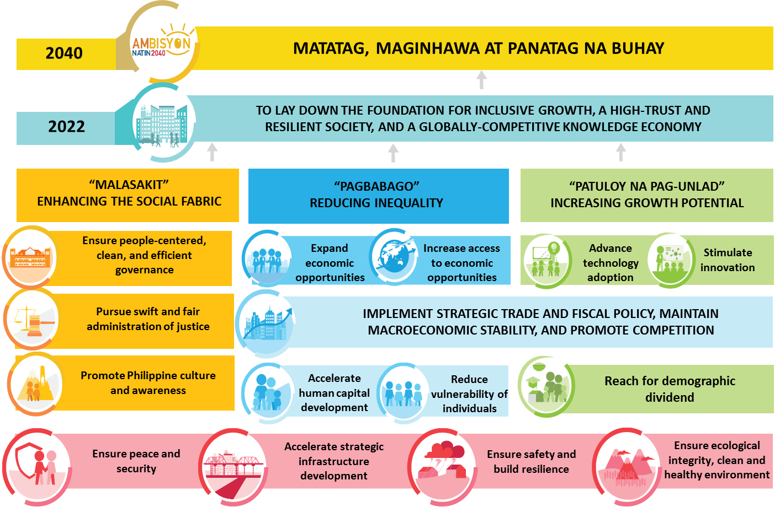
2017 – 2022 Philippine Development Plan
Notes:
Thus, our objectives in the implementation of the Results-Based Performance Management System (RBPMS) is anchored from the 2017-2022 Philippine Development Plan.
With the directives of the President toward realizing the 10-point socioeconomic development agenda for our citizens, bureaucracy is mandated to ensure fiscal efficiency in the planning and roll out of the programs and projects that directly responds to the needs of our citizens. It is high time for the bureaucracy to move forward with a whole-of-government approach and intensify our collaboration to achieve societal goals.
Because of its integrated approach in performance management, monitoring and evaluation, the RBPMS features a comprehensive framework that cuts across several performance management levels.
Over the years, the RBPMS has been an integrated network of government tools for performance management, monitoring and measurement of the performance of the entire bureaucracy. The framework also incorporates other metrics on performance excellence such as citizen satisfaction, financial stewardship, internal process efficiency, and leadership, learning and growth.
Through the RBPMS, there is a direct link of performance of individuals, delivery units and agencies with the achievement of sectoral outcomes and societal goals. By aligning the individual targets with bureau and organization-level goals which are closely tied up with sectoral and societal outcomes, every individual in government service is regarded a vital component of the national plan and a key agent of social change.

Slide 10
AO 25 Inter-Agency Task Force (IATF)
Task Force Members
Oversight Partners
Technical Secretariat

Slide 11
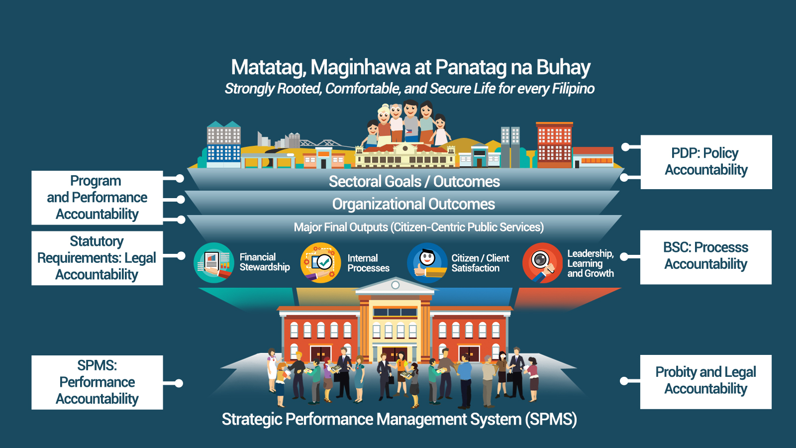
RBPMS Framework
Notes:
With these initiatives in ensuring that each one of us is sharing the responsibilities in making our government and country better, we have also modified the RBPMS Framework by including new components such as the (1) Streamlining and Process Improvements, (2) Citizen/Client Satisfaction, and (3) Strengthened Integrity, Transparency and Accountability.
In attaining our Societal Goals and Outcomes as reflected in the Philippine Development Plan 2017-2022, we have aligned our Organizational Outcomes through the realization and implementation of programs and projects for our citizens. As we focus on achieving these goals, we also take into consideration the importance of expediting and streamlining government transactions and effecting change through improvements in our processes and systems within our respective agencies. Hence, we recognize the significance of the feedback from our clients through the Citizen/Client Satisfaction as we continually enhance the delivery of quality public service, short of delays, red tape, and recurring issues.
/
As we include new elements in the RBMPS Framework, we continue to be guided by our objective to have effective (1) Leadership, Learning and Growth, systematic (2) Internal Processes, reinforced (3) Integrity, Transparency and Accountability, and responsible (4) Financial Stewardship within our agencies.
The RBPMS framework ensures that through our individual performances, we certainly contribute to the attainment of our organizational goals up to our societal/sectoral goals.

Slide 12
Phases of RBPMS
Initiation
Phase
Harmonization
Phase
Stabilization
Phase
Institutionalization Phase
Tightening
Phase
Focusing results that matter to citizens
2012
2013
2014
2015
2016
2017
2018
2019

Slide 13
High participation rate
In 2018, nine (9) OEOs were transferred to Departments through EO No. 62 and EO No. 67.
Since 2015, attached agencies were validated as unique entities.
LGUs adapted PBB implementation beginning 2017. Their participation is based on their compliance with SGLG core areas.
Previous years’ participation rate:
FY 2014 – 99%
FY 2013 – 98%
FY 2012 – 96%
Notes:
*COMELEC does not participate but is encouraged to join the PBB implementation.

Slide 14
Compliance to Good Governance Conditions
2011 | 2012 | 2013 | 2014 | 2015 | 2016 | 2017 | 2018
Initial year of implementation | 87% | 89% | 98% | 98% | 98% | 77% | 75%
32% awards posted vs. total notices | 80% | 89% | 95% | 92% | 93% | 79% | 58%
79.8% | 90% | 96% | 99% | 98% | 99% | 90% | 95%
-NA- | -NA- | 96% | 98% | 99% | 99% | 99% | Validated by SALN Review Committee
-NA- | 97% | 98% | 100% | 99% | 97% | 90% | Required as Individual eligibility
-NA- | -NA- | -NA- | -NA- | 97% | 83% | 55% | 65%
-NA- | -NA- | -NA- | -NA- | 88% | 93% | 83% | 41%
-NA- | -NA- | -NA- | -NA- | 94% | 96% | 83% | 88%
Transparency Seal
PhilGEPS
Citizen’s Charter
SALN Submission
Report on
Ageing of CA
QMS
APP
APCPI
Notes:
Through the RBPMS, there has been an improved compliance to Statutory Legal requirements and Good Governance Conditions. We have seen a consistent increase in compliance to the following requirements since FY 2012.
However, due to the implementation of a stricter validation process and period in FY 2017, we can see here that there was a decrease in the percentage of agencies who have met and complied with the requirements.

Slide 15
Status of FY 2018 PBB

Slide 16
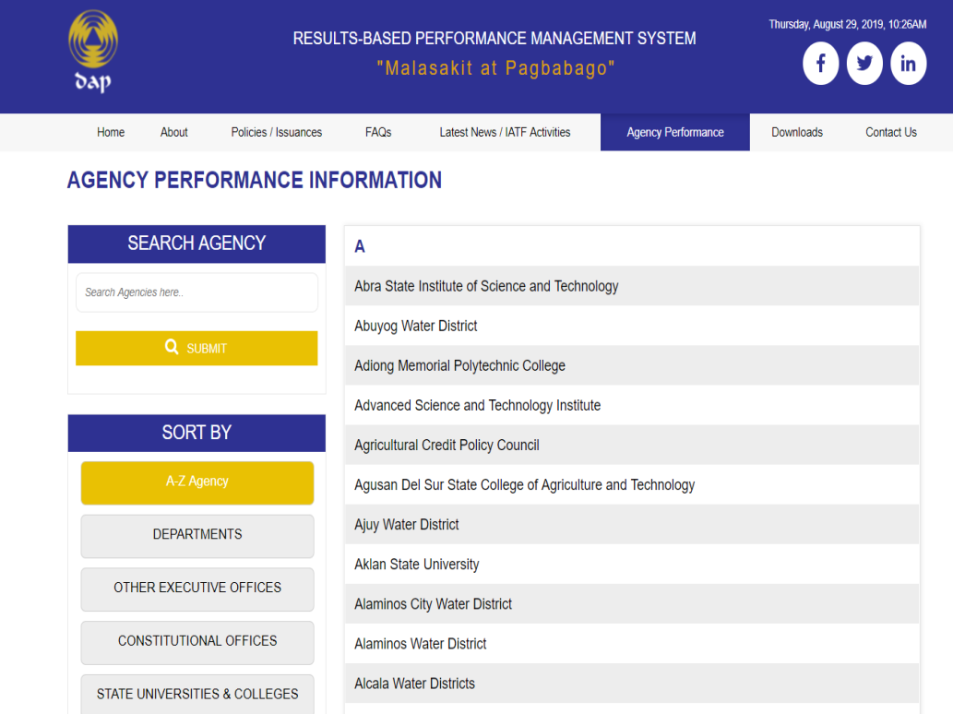
Heightened transparency of agencies
thru the Online Monitoring System of Agency Compliance and Performance Scorecards
http://www.dap.edu.ph/rbpms/agency-performance/

Slide 17
FY 2018 GGC Compliance
 | TS | PhilGEPS | ARTA | ISO-QMS
Depts & Attached Agencies | 93% | 63% | 96% | 68%
COs and others | 80% | 60% | 100% | 80%
OEOs | 93% | 67% | 100% | 50%
GOCCs covered by DBM | 80% | 67% | 93% | 67%
SUCs | 84% | 51% | 92% | 60%
TOTAL | 89% | 59% | 95% | 64%
GOCCs under GCG | 42% | 63% | 67% | 57%
LWDs | 49% | 83% | 80% | 94%
*as of September 26, 2019

Slide 18
FY 2018 Procurement Requirement Compliance
 | 2018 APP Non-CSE | Indicative 2019 APP Non-CSE | APCPI | 2019 APP CSE | 50% Early Procurement Activities (EPA)
Depts & Attached Agencies | 41% | 98% | 91% | 97% | -
COs and others | 0% | 80% | 80% | 100% | -
OEOs | 40% | 97% | 73% | 93% | -
GOCCs covered by DBM | 53% | 93% | 93% | 87% | -
SUCs | 33% | 95% | 91% | 79% | -
TOTAL | 38% | 96% | 89% | 90%
GOCCs under GCG | 42% | 63% | 75% | 65% | Awaiting validating result
LWDs | 59% | 69% | N/A | 78% | N/A
*as of September 26, 2019

Slide 19
FY 2018 COA and Other Cross-Cutting Requirement Compliance
 | COA FS | Sustained Compliance to AAR | FOI Program | Review and Compliance Procedure of SALN | SRR
Depts & Attached Agencies | 99% | 95% | 91% | - | 80%
COs and others | 100% | 80% | Not covered by FOI | - | 80%
OEOs | 100% | 100% | 97% | - | 87%
GOCCs covered by DBM | 100% | 87% | 87% | - | 73%
SUCs | 100% | 85% | 93% | - | 73%
TOTAL | 99% | 92% | 95% |  | 78%
GOCCs under GCG | 88% | 72% | 65% | Awaiting validation result | 50%
LWDs | 97% | 69% | 69% | Awaiting validation result | 57%
*as of September 26, 2019

Slide 20
FY 2018 Performance Targets Compliance
Streamlining and Process Improvements; Result of Citizen/Client Satisfaction
Status: on-going review
Agency submissions (Annex 3A, 3B, and CCS) are reviewed based on the ff:
Timeliness of submission
Completion of Forms 3A/A1
Coverage of critical services based on the mandates and functions of the agency (as declared in the CC)
Substantive content of Form 3A/A1
Notes:
The agency submissions are being reviewed by the AO 25 Composite Team members.
Deadline of submissions for small agencies: February 28, 2019
For big agencies: August 31, 2019
Agency submissions (Annex 3A, 3B, and CCS) are reviewed based on the ff:
Timeliness of submission
Completion of Forms 3A/A1
Coverage of critical services based on the mandates and functions of the agency (as declared in the CC)
Substantive content of Form 3A/A1

Slide 21
General Observations on Agency Submissions
1. Incomplete and not properly filled-out forms.
2. Unclear definition and identification of frontline/non-frontline services.
3. Mandates and functions of the agencies were not captured in the agency's declared critical services.
4. No declared targets for each criteria.
5. No streamlining efforts done in FY 2018.
6. No sufficient explanations, justifications, and/or supporting documents.
7. No Client/Citizen’s Satisfaction survey done.
Notes:
1. Incomplete and not properly filled-out forms.
2. Unclear definition and identification of frontline/non-frontline services.
3. Mandates and functions of the agencies were not captured in the agency's declared critical services.
4. No declared targets for each criteria.
5. No streamlining efforts done in FY 2018.
6. No sufficient explanations, justifications, and/or supporting documents.
7. No Client/Citizen’s Satisfaction survey done.
(give examples)

Slide 22
FY 2019 PBB Guidelines

Slide 23
Guiding Principles of FY 2019 PBB
Making government equipped with political will.
Encourage more efficient government processes.
Obtain people’s satisfaction and feedback.
Engage agencies in monitoring compliance and performance.
Uphold public accountability and heightened transparency.
Observe strong financial discipline and responsible budget allocation.
Notes:
Focus on making a government equipped with political will.
Encourage more efficient government processes through streamlining and improvements.
Obtain people’s satisfaction and feedback in enhancing government services and engage them in monitoring compliance and performance.
Uphold public accountability and heightened transparency.
Observe strong financial discipline and responsible budget allocation.

Slide 24
Sec. 2.0 Coverage
Departments and Attached Agencies, COs, OEOs and GOCCs under DBM
State Universities and Colleges (SUCs)
Kindly note that the CHED may issue separate guidelines for the SUCs with regards to the achievement of their FY 2019 targets.
Interim PBB of the ff:
GCG for GOCCs covered by RA No. 10149 (GCG MC No. 2019-02)
LWUA for Local Water Districts (LWDs)
DILG for Local Government Units (LGUs) (same with 2018)
Notes:
Departments and Attached Agencies, COs, OEOs and GOCCs under DBM
The DBM, OP-OES, OP-OCS will work closely with the Task Force in this implementation.
State Universities and Colleges (SUCs)
Kindly note that the CHED may issue separate guidelines for the SUCs with regards to the achievement of their FY 2019 targets.
Interim PBB of the ff:
GCG for GOCCs covered by RA No. 10149 (GCG MC No. 2019-02)
LWUA for Local Water Districts (LWDs)
DILG for Local Government Units (LGUs)

Slide 25
Sec. 3.0 Eligibility Criteria
Satisfy 100% of the Good Governance Conditions (GGCs).
Achieve each of the Performance Targets - Physical Targets, STO, and GASS requirements.
Performance rating of employees and CES positions.
Notes:
Satisfy 100% of the Good Governance Conditions (GGCs).
Achieve each of the Performance Targets - Physical Targets, STO, and GASS requirements.
Performance rating of employees and CES positions.

Slide 26
Sec. 4.0 Good Governance Conditions (1/4)
Maintain/Update Transparency Seal
Post/Update PhilGEPS postings
Maintain/Update Citizen’s Service Charter
Non-compliance with any GGC will render the entire department/agency ineligible for the PBB.
Assessment of agency compliance with GGCs shall start on October 1, 2019.
Notes:
Maintain/Update Transparency Seal
Post/Update PhilGEPS postings
Maintain/Update Citizen’s Service Charter
Non-compliance with any GGC will render the entire department/agency ineligible for the PBB.
Assessment of agency compliance with GGCs shall start on October 1, 2019.

Slide 27
Sec. 4.0 Good Governance Conditions (2/4)
Maintain/Update Transparency Seal –
Agency’s mandate and functions
Annual Financial Reports
DBM Approved Budget and Corresponding Targets for FY 2019
Major Projects, and Programs, Beneficiaries, and Status of Implementation for FY 2019
FY 2019 APP Non-CSE, Indicative FY 2020 APP Non-CSE, and FY 2019 APP CSE
QMS Certification
System of Agency Ranking Delivery Units for FY 2019 PBB
The Agency Review and Compliance Procedure of Statements of Assets, Liabilities, and Net Worth (SALN) and Financial Disclosures
FOI Manual and all other FOI requirements
Refer to:
Guideline on
Transparency Seal
Annex 2
Notes:
Maintain/Update Transparency Seal –
Agency’s mandate and functions
Annual Financial Reports
DBM Approved Budget and Corresponding Targets for FY 2018
Major Projects, and Programs, Beneficiaries, and Status of Implementation for FY 2018
FY 2018 APP Non-CSE, Indicative FY 2019 APP Non-CSE, and FY 2019 APP CSE
QMS Certification
System of Agency Ranking Delivery Units for FY 2018 PBB
The Agency Review and Compliance Procedure of Statements and Financial Disclosures
FOI Manual and all other FOI requirements

Slide 28
Sec. 4.0 Good Governance Conditions (3/4)
Post/Update PhilGEPS postings –
Including all Invitations to Bids and awarded contracts.
Covers Early Procurement of FY 2020 Non-CSE items.
Above Php 1 Million transactions from January 1 to December 31, 2019 (cut-off date).
Agencies should track their status through the PhilGEPS microsite: http://data.philgeps.gov.ph/directory/pbb.aspx
Refer to:
Guideline on
PhilGEPS Posting
Annex 6
Notes:
Post/Update PhilGEPS postings –
Including all Invitations to Bids and awarded contracts.
Covers Early Procurement of FY 2020 Non-CSE items.
Above Php 1 Million transactions from January 1 to December 31, 2019 (cut-off date)*.
Agencies should track their status through the PhilGEPS microsite: http://data.philgeps.gov.ph/directory/pbb.aspx

Slide 29
Sec. 4.0 Good Governance Conditions (4/4)
Maintain/Update Citizen’s Service Charter –
Reflecting the agency's enhanced service standards for all government services consistent with RA No. 11032.
The submitted Certificate of Compliance (CoC) shall be the basis for the validation for FY 2019 and shall be sent to the Anti-Red Tape Authority (ARTA) on or before December 06, 2019 to compliance@arta.gov.ph
Refer to:
ARTA CoC template
*MC 2019-002 Guidelines on the Implementation of the Citizen’s Charter in Compliance with RA No. 11032
Notes:
ARTA deadline – December 6, 2019
AO 25 deadline – December 31, 2019
Maintain/Update Citizen’s Service Charter –
Reflecting the agency's enhanced service standards for all government services consistent with RA No. 11032.
The submitted Certificate of Compliance (CoC) shall be the basis for the validation for FY 2019 and shall be sent to the Anti-Red Tape Authority (ARTA) on or before December 31, 2019 to compliance@arta.gov.ph
The ARTA validation shall be complemented with reports on feedback and complaints from citizens gathered by the OP, PMS, CSC and PCOO from the 8888 Hotline and the FOI portals.

Slide 30
Sec. 5.0 Performance Targets (1/3)
Departments and Attached Agencies, COs, OEOs and GOCCs under DBM –
Streamlining and Process Improvement of Agency’s Critical Services
FY 2019 STO requirement
FY 2019 GASS requirements
Notes:
Departments and Attached Agencies, COs, OEOs and GOCCs under DBM –
Streamlining and Process Improvement of Agency’s Critical Services
FY 2019 STO requirement
FY 2019 GASS requirements

Slide 31
Sec. 5.0 Performance Targets (2/3)
State Universities and Colleges (SUCs) –
Achievement of all Congress-approved performance targets under the FY 2019 GAA (Major Financial Outputs)
FY 2019 STO requirement
FY 2019 GASS requirements
Forms to submit:
Annex 5 - Modified Form A
Modified Form A1
Notes:
State Universities and Colleges (SUCs) –
Achievement of all Congress-approved performance targets under the FY 2019 GAA (Major Financial Outputs)
FY 2019 STO requirement
FY 2019 GASS requirements

Slide 32
Sec. 5.0 Performance Targets (3/3)
GOCCs covered by RA No. 10149 –
Targets reflected in their approved FY 2019 Performance Scorecard and eligibility requirements specified in the Guidelines to be issued by GCG.
Local Water Districts –
Achievement of the physical targets, STO and GASS indicators as identified in the Guidelines to be issued by LWUA and DBM.
Local Government Units –
Performance targets based on the Guidelines to be issued by DILG and DBM.

Slide 33
Sec. 5.1 Streamlining and Process Improvements of the Agency’s Critical Services
Agencies shall determine and report improvements on the following:
Number of steps
Turnaround Time (TAT)
Number of signatures
Number of required documents
Transaction costs
Substantive compliance costs
Forms to submit:
Annex 3A
Annex 3B
Notes:
Agencies shall determine and report improvements on the following:
Number of steps
Turnaround Time (TAT)
Number of signatures
Number of required documents
Transaction costs
Substantive compliance costs

Slide 34
Definition of Terms (1/4)
Critical Service/s – all G2C, G2B, and G2G transactions as declared in the Citizen’s/Service Charter.
Number of steps – number of steps the transacting client has to complete in availing a service.
Turnaround Time (TAT) – sum of the waiting time and processing time. TAT starts from the moment the transacting client enters the queue or fills out the form, and the waiting time incurred until the service has been completed/delivered.
Notes:
Critical Service/s – all Government-to-Citizens (G2C), Government-to-Business (G2B), and Government-to-Government (G2G) transactions as declared in the Citizen’s/Service Charter.
Number of steps – refers to number of steps the transacting client has to complete in availing a service. Departments/agencies shall report in detail the steps necessary to complete the service including flow charts indicating the front end and back end.
Turnaround Time (TAT) – the sum of the waiting time and processing time. TAT starts from the moment the transacting client enters the queue or fills out the form, and the waiting time incurred until the service has been completed/delivered.

Slide 35
Definition of Terms (2/4)
Number of signatures – number of signatures and initials from the employees and officers of the department/agency necessary to complete each service.
Number of required documents – total number of required documents that must be provided by the transacting client to the government.
Notes:
Number of signatures – number of signatures and initials from the employees and officers of the department/agency necessary to complete each service.
Number of required documents – total number of required documents that must be provided by the transacting client to the government.

Slide 36
Definition of Terms (3/4)
Transaction costs – costs incurred by the transacting client in the course of availing of a government service. These costs are categorized as follows:
Primary Transaction Costs/Fees - fees declared in the agency’s Citizen’s/Service Charter to be paid to the department/agency by the transacting client for availing a government service.
Ex. application fees, registration fees, etc.
Other Transaction Costs - other costs incurred by the transacting client to obtain supporting information from another agency in order to secure the necessary primary information.
Ex. birth certificates to secure passports, required photos, printing and photocopying costs, transportation expenses of the transacting client, etc.
Notes:
Transaction costs – costs incurred by the transacting client in the course of availing of a government service. These costs are categorized as follows:
Primary Transaction Costs/Fees - fees declared in the agency’s Citizen’s/Service Charter to be paid to the department/agency by the transacting client for availing a government service.
Ex. fees are application fees, registration fees, etc.
Other Transaction Costs - other costs incurred by the transacting client to obtain supporting information from another agency in order to secure the necessary primary information.
Ex. birth certificates to secure passports, required photos, printing and photocopying costs, transportation expenses of the transacting client, etc.

Slide 37
Definition of Terms (4/4)
Substantive Compliance Costs – incremental costs other than administrative costs incurred by the transacting public in the course of complying with a regulation. These costs can include implementation costs, direct labor costs, overhead costs, equipment costs, material costs, and external service costs.
Ex. purchase of early warning device for vehicle owners, expenses in the installation of accelerograph for building with 10 floors and up, costs in the maintenance of waste disposal system for establishment, etc.
Notes:
Substantive Compliance Costs – incremental costs other than administrative costs incurred by the transacting public in the course of complying with a regulation. These costs can include implementation costs, direct labor costs, overhead costs, equipment costs, material costs, and external service costs.
Ex. purchase of early warning device for vehicle owners, expenses in the installation of accelerograph for building with 10 floors and up, costs in the maintenance of waste disposal system for establishment, etc.

Slide 38
Annex 3A – Modified Form A
Target in
FY 2019 &
Streamlining Efforts
Streamlining Criteria
Frontline Services
Non- Frontline Services
Click Sample Form 3A
Notes:
Tech will click sample Form 3A

Slide 39
Annex 3B – Modified Form A1
Identified clients
# of clients served in 2019
volume of transactions in 2019
Streamlining Criteria
Status as of
FY 2018
Target in
FY 2019
FY 2019 Status of Streamlining Efforts
Remarks
Click Sample Form 3A1
Notes:
Tech will click sample Form 3B

Slide 40
Sec. 5.2 Citizen/Client Satisfaction
Citizen/Client Satisfaction– to determine the effectiveness of the streamlining and process improvements initiated by agencies, the satisfaction level of the citizens/clients should be measured and reported.
Report feedback mechanisms
Citizen/client satisfaction measurement
Using the improvement action plan that agencies reported for FY 2018 PBB, agencies shall report the results of each action plan and the FY 2019 Citizen/Client Satisfaction Survey for each service.
Refer to:
Citizen/Client Satisfaction Report
Annex 4
Notes:
Citizen/Client Satisfaction– to determine the effectiveness of the streamlining and process improvements initiated by agencies, the satisfaction level of the citizens/clients should be measured and reported.
Report feedback mechanisms
Citizen/client satisfaction measurement
Using the improvement action plan that agencies reported for FY 2018 PBB, agencies shall report the results of each action plan and the FY 2019 Citizen/Client Satisfaction Survey for each service.

Slide 41
Sec. 5.3 STO Requirement
ISO 9001:2015 QMS Certification
Or equivalent certifications/attestations granted by similar internationally recognized bodies promoting TQM shall be considered: PQA, ISO/IEC 17025, ISO 17020, and Qmentum Accreditation Canada
To submit:
Copy of ISO Certification
Posting in the TS
Other documents required by DBM-SPIB
Notes:
Beginning FY 2018, for the Support to Operations (STO) requirement, we will be requiring agencies to have their QMS Certified. Agencies should have ISO 9001: 2015
QMS Certification or Or equivalent certifications/attestations granted by similar internationally recognized bodies promoting TQM shall be considered: PQA, ISO/IEC 17025, ISO 17020, and Omentum Accreditation Canada.

Slide 42
Sec. 5.4 GASS Requirements (1/3)
100% Obligations and Disbursements BUR
Quarterly BFARs
FY 2020 Indicative APP
FY 2019 APP-non CSE
FY 2019 APP CSE
FY 2018 APCPI
COA Financial Reports
Sustained compliance w/ full implementation of 30% of the prior years’ audit recommendations
Undertaking of Early Procurement Activities – 50% goods and services
Notes:
The General Administrative Support Services (GASS) requirements:
100% Obligations and Disbursements BUR
Quarterly BFARs
FY 2020 Indicative APP
FY 2019 APP-non CSE
FY 2019 APP CSE
FY 2018 APCPI
COA Financial Reports
Sustained compliance w/ full implementation of 30% of the prior years’ audit recommendations
Undertaking of Early Procurement Activities – 50% goods and services

Slide 43
Sec. 5.4 GASS Requirements (2/3)
For NGAs and SUCs*:
Obligations BUR = Total Obligations
Total Allotments
Disbursements BUR = Total Disbursements
Total Obligations
Notes:
Obligations BUR computed as obligation rates for MOOE and CO of all programs, activities, and projects funded in FY 2018 from all appropriation sources, including those released under the General Appropriations Act as the allotment order policy, net of savings from procurement, and implementation of cost-cutting measures;
Disbursements BUR which is measured by the ratio of total disbursements (cash and non-cash, excluding Personnel Services) to total obligations for
MOOE and CO in FY 2018, net of goods and services obligated by December 31, 2018 but accounts payable and not yet due and demandable on the said date.
*For SUCs, shall include the submission of their earmarked income

Slide 44
Sec. 5.4 GASS Requirements (3/3)
For GOCCs under DBM:
Obligations BUR = Total Obligations
DBM approved Corporate Operating Budget (both net of PS)
Disbursements BUR = Total Actual Disbursements
Total Actual Obligations
(both net of PS)
Notes:
Obligations BUR = Total Obligations / DBM Approved Corporate Operating
Budget (both net of Personnel Services)
Disbursement BUR = Total Actual Disbursement / Total Actual obligations
(both net of Personnel Services)

Slide 45
Sec. 5.5 Cross-cutting requirements
Establishment and Conduct of Agency Review and Compliance Procedure of SALN
FOI Program (submission to PCOO and posting on TS)
FOI Manual
Agency Information Inventory
2019 FOI Summary Report
2019 FOI Registry
Screenshot of agency website’s homepage with FOI logo
Notes:
Establishment and Conduct of Agency Review and Compliance Procedure of SALN
Call Danica for PCOO presentation
Comply with FOI Program
(submission to PCOO and posting on TS)
FOI Manual
Agency Information Inventory
2019 FOI Summary Report
2019 FOI Registry
Screenshot of agency website’s homepage with FOI logo

Slide 46
Sec. 6.0 Eligibility of Individuals
Employees belonging to the First, Second and Third Levels should receive a rating of at least “Satisfactory” based on the agency's CSC-approved Strategic Performance Management System (SPMS) or the requirement prescribed by the CESB.
An official or employee who has rendered a minimum of 9 months of service during the fiscal year and with at least Satisfactory rating may be eligible to the full grant of the PBB.
Employees who transferred from non-participating gov’t agencies shall be rated where he/she served the longest.
Eligible employee shall receive the PBB on pro-rata basis corresponding to the actual length of service to the participating agency.

Slide 47
Sec. 6.8 Individual Eligibility
Length of Services | % of PBB
8 months but less than 9 months | 90%
7 months but less than 8 months | 80%
6 months but less than 7 months | 70%
5 months but less than 6 months | 60%
4 months but less than 5 months | 50%
3 months but less than 4 months | 40%
Official/s or employee/s who rendered less than 9 months but a minimum of 3 months of service and with at least a Satisfactory rating.

Slide 48
Ranking and Rating
Sec. 7.0 Ranking of Delivery Units
Sec. 8.0 Rates of PBB
Ranking | Performance Category
Top 10% | Best Delivery Units
Next 25% | Better Delivery Units
Next 65% | Good Delivery Units
Performance Category | Multiple of Basic Salary
Best Delivery Unit | 0.65
Better Delivery Unit | 0.575
Good Delivery Unit | 0.50
To submit:
Form 1.0
Notes:
Ranking and Rating
Sec. 7.0 Ranking of Delivery Units
Departments/Agencies and their corresponding offices/delivery units that meet the criteria and conditions are eligible to the PBB. Bureaus, offices or delivery units eligible to the PBB shall be forced ranked.
Sec. 8.0 Rates of PBB
The rates of the PBB for each individual shall be based on the performance ranking of the individual’s bureaus or delivery units with the rate of incentive as a multiple of one’s monthly basic salary.

Slide 49
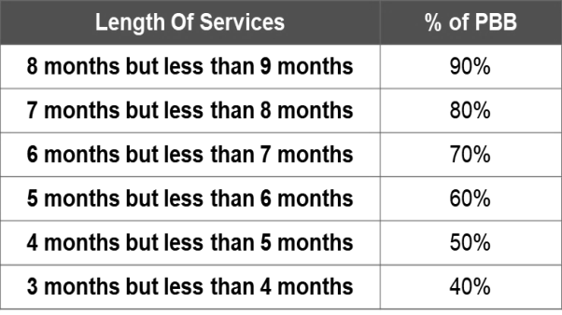
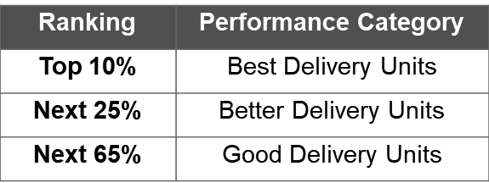
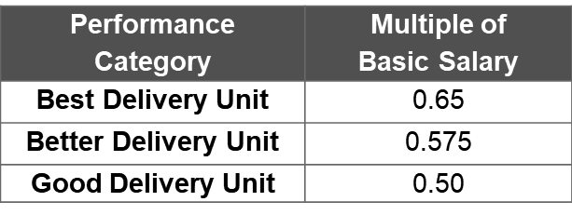
Summary of FY 2019 Conditions/Requirements
Coverage | Conditions/Requirements
All Departments and attached agencies, Constitutional Offices, Other Executive Offices, and GOCCs under DBM. State Universities and Colleges Interim PBB: - GOCCs under GCG - Local Water Districts - Local Government Units | Good Governance ARTA, TS, PhilGEPS
 | STO ISO QMS, STO Indicator identified by the agency
 | GASS BUR, BFARs, COA 30% AR, APP CSE, APP non-CSE, Early Procurement Activities, APCPI
 | Other cross-cutting SALN, FOI Program
Satisfy 100% of the Good Governance Conditions (GGCs). Achieve each of the Performance Targets - Physical Targets, STO, and GASS requirements. Performance rating of employees and CES positions.
 | Performance Targets NGAs - Streamlining and process improvement; client satisfaction SUCs - GAA approved performance targets GOCCs, LWDs, LGUs - Performance Scorecard and/or eligibility criteria specified by the GCG, LWUA, and DILG.
Pro-rata Scheme for Individual Eligibility
Ranking of Delivery Units
Eligibility Criteria
Rates of PBB

Slide 51
Dates to Remember
2019
2020
OCTOBER
01 – Transparency Seal
Agency SALN Review and Compliance Procedure
System of Rating and Ranking
30 – Q3 BFARs
31 – FY 2020 APP-CSE
NOVEMBER
30 – People’s FOI Manual
DECEMBER
31 – Citizen’s/Service Charter CoC
Sustained Compliance w/ Audit Findings
QMS Certification
MARCH
30 – COA Financial Reports (small agencies)
31 – FY 2019 APP-non CSE
Results of FY 2018 APCPI System
APRIL
30 – Q1 BFARs
30 – COA Financial Reports (big agencies)
SALN of employees
JULY
30 – Q2 BFARs
SEPTEMBER
30 – Indicative FY 2020 APP-non CSE
JANUARY
30 – Q4 BFARs
31 – PhilGEPS Posting
Early Procurement Activities
Agency Information Inventory
2019 FOI Registry and FOI Summary Report
Screenshot of agency’s home page
FEBRUARY
28 – Small agencies:
Streamlining and Process Improvements, Citizen/Client Satisfaction, and Form 1.0 and PBB Evaluation Matrix
SUCs - Physical targets
AUGUST
31 – GOCCs, LWDs, LGUs:
Physical Targets
Big agencies:
Streamlining and Process Improvements
Citizen/Client Satisfaction
Form 1.0 and PBB Evaluation Matrix
Notes:
Red – past due
Green – upcoming deadlines

Slide 52
Information and Communication
The Department Secretary / Head of Agency should designate senior officials as PBB Focal Person/s and PBB spokesperson/s and confirm with the IATF the name, position and contact details.
Departments / Agencies should strengthen their communications strategy and ensure transparency and accountability in the implementation of the PBB.
IATF Communication Channels
http://www.dap.edu.ph/rbpms
facebook.com/PBBSecretariat
ao25secretariat@dap.edu.ph
twitter.com/PBBSecretariat
0920-498-9121 / (02) 631-2139
(02) 400-1469 / (02) 400-1582
(02) 400-1490
http://www.dap.edu.ph/rbpms/policies-issuances

Slide 53
Open Forum
Notes:
Emcee to entertain questions.

