Slide 1
AO 25 Technical Working Group
Meeting with
PBB Focal Persons
14 February 2019
L. S. Virata Hall, Development Academy of the Philippines

Slide 2
WELCOME
PBB Focal Persons
from National Government Agencies

Slide 3
Join the conversation!
Share your thoughts
and ask questions.

Slide 4
Status of FY 2017 PBB
307 participating agencies
Eligibility – 42% or 129 qualified agencies
Releases –121 out of 129 agencies already received their PBB

Slide 5
FY 2018 PBB
Orientation on the Guidelines of FY 2018 PBB
14 June 2018
523 focal persons from 271 agencies

Slide 6
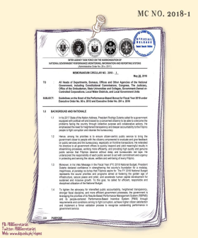
Focusing on the Results
that Matter to Citizens
Working Towards Streamlined Government Services
DAP Training on Streamlining for NGAs
Promotion of streamlining and process improvements in all National Government Agencies (NGAs) through:
Simplified requirements and procedures
Reduced number of signatures
Standardized transaction processing time
Automation of business-related transactions
Centralized information and communications technology
* with the DAP-Productivity Development Center
Introduction to Streamlining Process
Lean Principles
7 Wastes + 1
Work Simplification Concepts
ECRS Principle
Design Thinking Approach
Value Stream Mapping
Tools in Streamlining Process
5s
5 Whys
Forms Design
According to RA No. 11032 s. 2018 (EODB Act), the prescribed time for government transactions are:
working days
for simple transactions
working days for complex transactions
working days for highly technical transactions
**These targets were also adopted in MC No. 2018-1 for the grant of the FY 2018 PBB.

Slide 7
Meeting Agenda
Feedback on PBB implementation
Discussion of FY 2018 PBB
- reminders on Agency Compliance
with the FY 2018 PBB requirements
Open Forum

Slide 8
We want your feedback
Let us know your present
experiences and practices
in implementing the
FY 2018 PBB.

Slide 9
REMINDERS
on Agency Compliance
with the FY 2018 PBB Requirements

Slide 11
Ensure compliance with the following
requirements that are past the deadline. (1/5)
Good Governance Conditions
Transparency Seal
PhilGEPS Postings
Citizen’s/Service Charter
October 1, 2018
January 31, 2019
August 1, 2018

Slide 12
Ensure compliance with the following
requirements that are past the deadline. (2/5)
Support to Operations
QMS Certification
December 31, 2018
General Administration and Support Services
Online Submission
of BFARs through URS
Q1 - April 15, 2018
Q2 - July 15, 2018
Q3 - October 15, 2018
Q4 - January 15, 2019

Slide 13
Ensure compliance with the following
requirements that are past the deadline. (3/5)
General Administration and Support Services
COA Financial Reports
Small agencies - March 30, 2018
Big Agencies - April 30, 2018
Procurement Documents
FY 2018 APP Non-CSE
Indicative FY 2019 APP-non CSE
FY 2019 APP CSE
Results of FY 2017 APCPI
January 31, 2018
August 31, 2018
Sustained Compliance with Audit Findings
December 31, 2018

Slide 14
Ensure compliance with the following
requirements that are past the deadline. (4/5)
Other cross-cutting requirements
Submission of SALN
April 30, 2018
FOI Compliance (1/2)
People’s FOI Manual
Agency Information Inventory
2017 FOI Summary Registry
2017 FOI Registry
Visible and functional FOI Logo
linked to the eFOI portal
September 30, 2018

Slide 15
Ensure compliance with the following
requirements that are past the deadline. (5/5)
Other cross-cutting requirements
FOI Compliance (2/2)
2018 FOI Summary Report
2018 FOI Registry
January 31, 2019
Agency Review and
Compliance Procedure of SALN
October 1, 2018
Posting of Agency’s System
of Ranking Delivery Units
October 1, 2018

Slide 16
REMINDERS
on upcoming
Important Dates to Remember

Slide 17
Important Dates to Remember
Physical Targets
Streamlining and Process Improvement
of Agency Services
Modified Form A and A1 (See Annexes 3A and 3B)
Small agencies -
Feb. 28, 2019
Big Agencies -
Aug. 31, 2019
Citizen/Client Satisfaction
Annex 4
Agency Ranking Report
Form 1 and PBB Evaluation Matrix
Annex 7 and PBB Evaluation Matrix
Budget Utilization Rate
Included in the Modified Form A (Annex 3A)

Slide 18
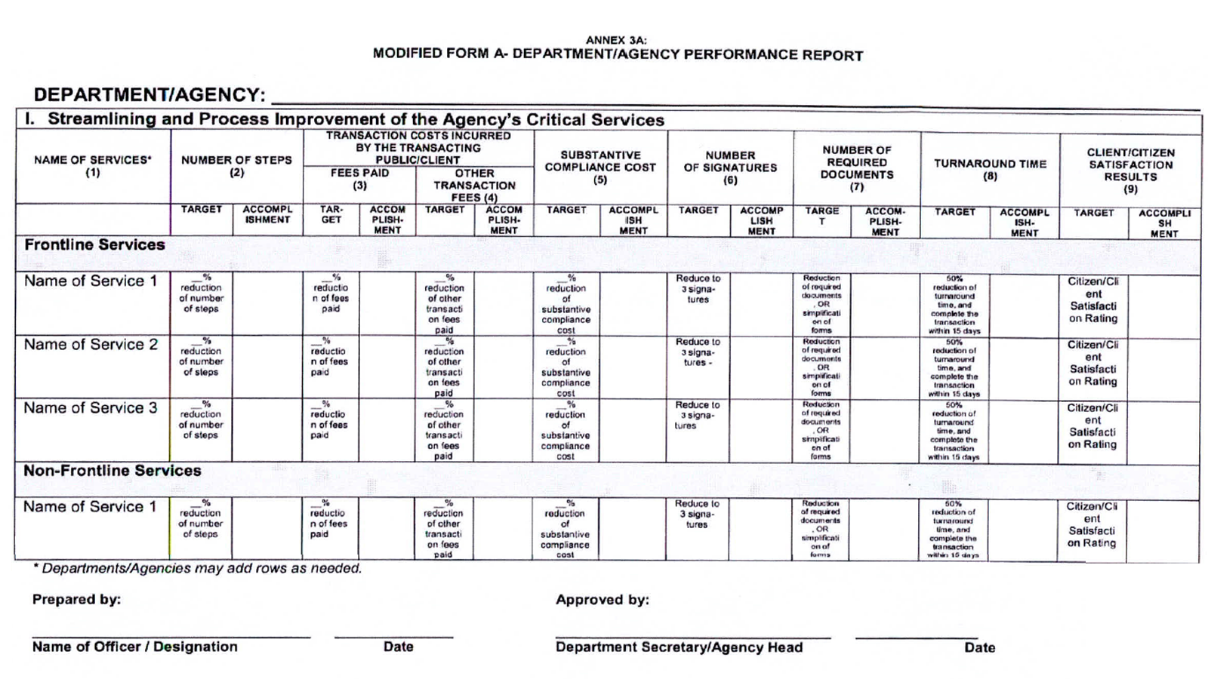
Annex 3A: Modified Form A

Slide 19
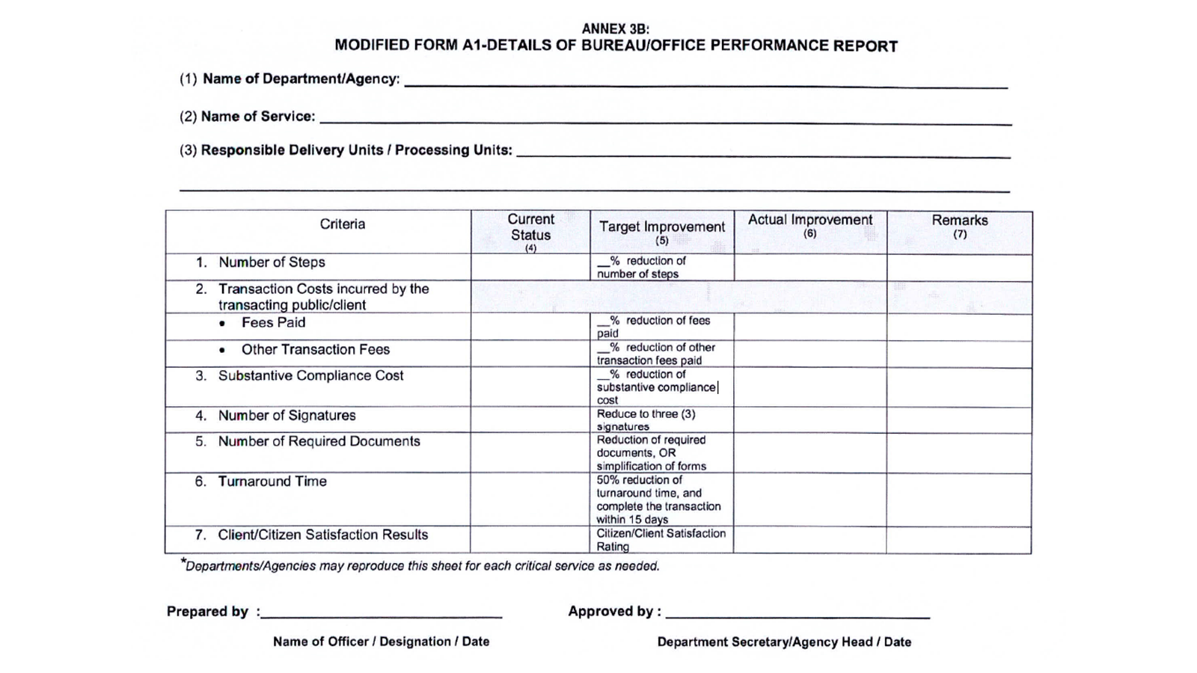
Annex 3B: Modified Form A1

Slide 20
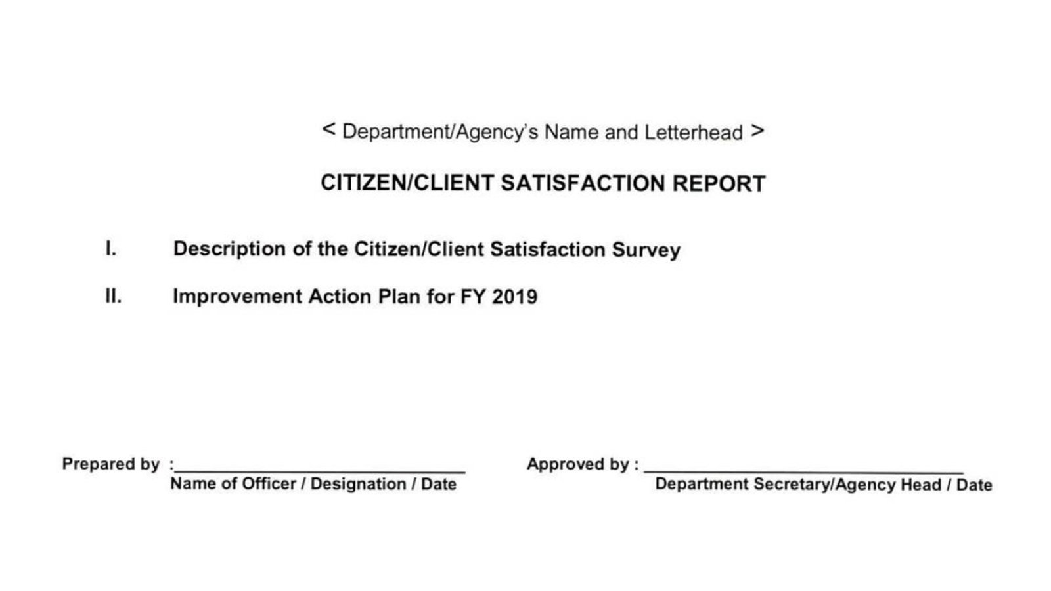
Annex 4: Citizen/Client Satisfaction Report

Slide 21
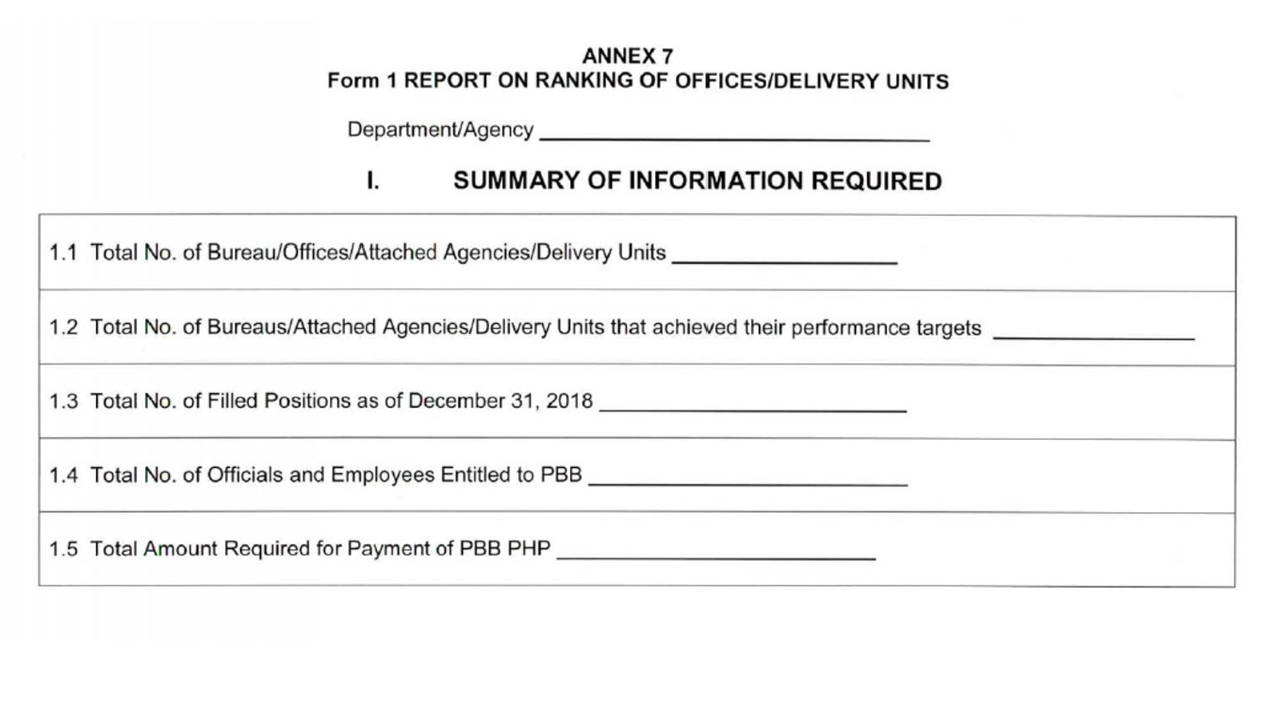
Annex 7: Form 1 Report on Ranking Delivery Units

Slide 22
Submission Reminders
Submit two (2) hard copies and e-copy of the agency accomplishment reports:
Annex 3A - Modified Form A
Annex 3B - Modified Form A1
Annex 4 - Citizen/Client Satisfaction Report
Annex 7 - Form 1 Agency Report on Ranking Delivery Units
PBB Evaluation Matrix
Complete supporting documents
Submit through the AO 25 Secretariat which shall endorse copies to the oversight/validating agencies for review. Ensure that all justifications and explanations are already attached to your submissions. All forms and reports should be signed by the agency head or the duly designated official.

Slide 23
Important Dates to Remember
The validation of Early Procurement condition
was moved to March 30, 2019
Submit Certificate of Compliance (Annex A of DBM Circular Letter No. 2018-12) and copy of APPs showing the status of Early Procurement Activities (Annex A of DBM Circular Letter No. 2018-8) to GPPB-TSO through email:
earlyprocurement@gppb.gov.ph

Slide 24
Open Forum

Slide 25
AO 25 IATF
Communication Channels

Slide 26
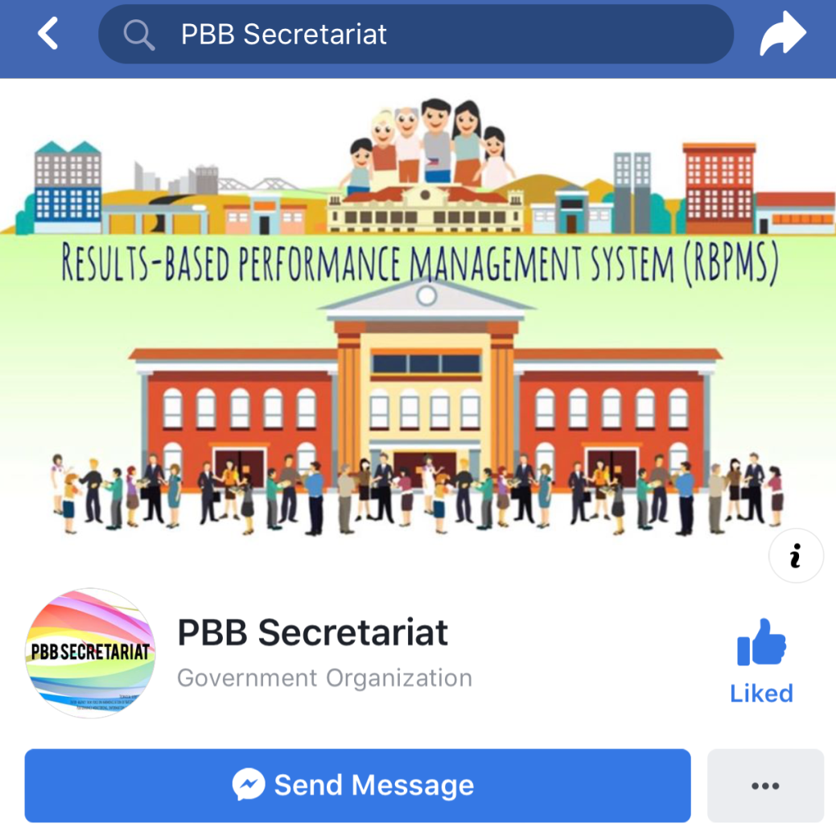
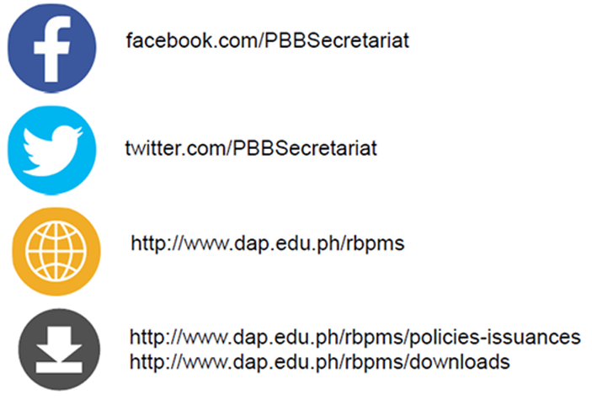
Cascade RBPMS information

