Slide 1









Inter-Agency Task Force on the Harmonization of National Government Performance, Monitoring, Information and Reporting Systems
AO 25 Technical Working Group Meeting
1 December 2015 1:00 pm - 5:00 pm Executive Lounge, Boncodin Hall, Department of Budget and Management Gen. Solano St., San Miguel, Manila
Government Oversight Partners:
CSC
GCG
Secretariat &
Technical Resource
CESB
COA
Ombudsman
NCC
CHED

Slide 2
Proposed Agenda
Time | Agenda Item | Responsible | Action Needed
1:00 – 1:05 | Call to Order | TWG Chair | Quorum
1:05 – 1:15 | Review and Approval of Minutes of Meeting on 18 August 2015 | TWG Members | For approval
1:15 – 1:30 | Business Arising from the Previous Meeting | AO25 Secretariat/ Concerned Agency | For Information
Business of the Day:
1:30 – 2:30 | Updates on 2015 Validation of GGC | AO25 Secretariat /Validating Agencies CSC COA GPPB DBM-OCIO PhilGEPS | For Information
 | - ARTA
 | - Financial Reports
 | - APP/APCPI
 | - Transparency Seal
 | - PhilGEPS Postings
 | - Posting of Rating and Ranking Guidelines (FY 2015)
2:30– 3:30 | 2. Non-Monetary Incentives | AO25 Secretariat | For Discussion
3:30– 4:30 | 3. RBPMS Implementation and Management in 2016-2017 | TWG Chair | For Discussion
4:30 – 5:00 | 4. Updated RBPMS Website | AO25 Secretariat | For Information

Slide 3
Review and Approval of Minutes of TWG Meeting on 18 August 2015

Slide 4
Business Arising from
Previous Meeting

Slide 5
BUSINESS ARISING from AUGUST 18 TWG MEETING | STATUS
Status of Release of FY 2014 PBB | 13 agencies out of the 173 eligible agencies have not received their PBB yet - DPWH, DOH, DOST, CHR, ERC, MMDA, SLeyteSU, TUP and UP 4 Departments have partial releases due to ongoing validation, revision or non-submission - DepED (OSEC, Division Offices, Regional Offices, attached agencies), DOLE (OSEC, ILS,NMP,NWPC and PRC), DILG (OSEC, BJMP, LGA, NPC, and PNP); and DOF (BOC, BLGF and BTr)
Study on how to improve the rating and distribution of PBB | Small group meetings held to discuss refinements on the PBB. Initial ideas to be discussed in the main agenda.
Advise agencies with difficulties with their 2015 PBB targets to inform and negotiate with oversight agencies adjustments in their targets. | CESB,PRRC, NAP, PDEA, BTr, BIR, BPSU, UEP and CARSU requested change in their targets/indicators for 2015 PBB. Request letters were forwarded to OP, BMBs and DBM-ROs. BIR and BTR’s requests were accepted by BMB-C.
Special Non-Monetary Recognition | Part of the main agenda
5. Create inter-agency coaching group | FGD with selected agencies conducted on September 10, 2015. Follow-up activity for discussion with TWG.
Notes:
DepEd released PBB to the schools level before Oct. 5

Slide 6
STATUS of 2014 PBB RELEASES
ELIGIBLE AGENCY | WITH RELEASED PBB | AMOUNT RELEASED | PBB NOT YET RELEASED
Departments (21) | 14 | Php 1,966,844,900 | 3 DPWH, DOH, DOST Note: 4 Partial Releases - DepED, DOLE, DILG,DOF
COs and others (5) | 4 | Php 338,618,850 | 1 CHR
OEOs (32) | 30 | Php 55,144,550 | 2 ERC, MMDA
GOCCs covered by DBM (12) | 12 | Php 63,349,695 | -
SUCs (103) | 100 | Php 831,673,900 | 3 SLeyteSU, TUP, UP
TOTAL (173) | 160 | Php 3,255,631,895 | 13 *Note: 4 Departments partially released

Slide 7
STATUS of 2014 PBB RELEASES
AGENCY | AMOUNT OF SARO RELEASED | TOTAL NUMBER OF OFFICIALS AND EMPLOYEES ENTITLED TO PBB
Departments | Php 1,966,844,900 | 188,310
COs | Php 338,618,850 | 43,019
OEOs | Php 55,144,550 | 5,504
GOCCs covered by DBM | Php 63,349,695 | 6,694
SUCs | Php 831,673,900 | 37,282
TOTAL | Php 3,255,631,895 | 280,809

Slide 8
REASONS FOR NON-RELEASES
AGENCY | STATUS
1. DPWH | SARO being processed by BMB for Economic Development Sector (Per Ms. Samillano on 11/27)
2. DepED National Council for Children’s Television National Book Development Board National Museum Philippine High School for the Arts | No Form 1.0 submission to date
3. DOH Office of the Secretary Commission on Population National Nutrition Council | OPCCB awaiting DOH’s revised Form 1.0 (Per Ms. Calces on 11/27)

Slide 9
REASONS FOR NON-RELEASES
AGENCY | STATUS
4. DOLE Office of the Secretary Institute for Labor Studies National Maritime Polytechnic National Wages and Productivity Commission Overseas Workers Welfare Administration Professional Regulation Commission | Revised Form 1.0 being evaluated (Per DBM-OPCCB on 11/26)
5. DOF Bureau of Customs Bureau of Local Government Finance Bureau of the Treasury | BOC and BLGF have yet to submit Form 1.0 (Per DBM-OPCCB on 11/27) SARO being processed by BMB for Economic Development Sector (Per Ms. Bolinao on 11/27)
6. DOST Office of the Secretary and all attached agencies | Revised Form 1.0 being evaluated (Per Ms. Calces of DBM-OPCCB on 11/27)

Slide 10
REASONS FOR NON-RELEASES
AGENCY | STATUS
7. DILG LG Sector/LGA BJMP, NPC, and PNP | SARO of BJMP and PNP being processed (Per Ms. Cabuyadao on 11/27) Form 1.0 of OSEC and NPC being reviewed (Per Ms. Joyce on 11/26)
8. CHR | Revised Form 1.0 being evaluated by OPCCB (Per Ms. Lumen n 11/26)
9. ERC | Form 1.0 for evaluation by DBM-OPCCB
10. MMDA | Form 1.0 being evaluated by DBM-NCR
11. SLeyteSU | Form 1.0 being evaluated by DBM RO-8
12. TUP | Form 1.0 being evaluated by DBM- NCR
13. UP | Form 1.0 being evaluated by DBM-NCR

Slide 11
Status of DepEd’s Compliance with 2014 PBB Requirements
Good Governance Conditions
Transparency Seal | Compliant as per DBM-OCIO on 5/25/2015
ARTA | Compliant as per CSC on 3/13/2015
SALN | Compliant since not in the negative list of OP, CSC and Ombudsman on 2/17/2015, 3/19/2015 and 3/27/2015, respectively
PhilGEPS | DepEd has 1 deficiency in PhilGEPS Posting for Division of Tagbilaran City. DepEd has yet to submit revised COC of Division of Tagbilaran City as of 11/27
Physical Accomplishments
Forms A and A-1 | Compliant as per BMB-B on 11/26/2015
Form B | Compliant as per PMS on 11/6/2015
Note: PBB of DepEd personnel at the school level were processed starting 9/22/2015. PBB of DepEd personnel at the central, regional and division levels (including DepEd attached agencies) has been WITHHELD pending clearance from PhilGEPS.

Slide 12
AGENCIES REQUESTING REVISIONS IN TARGETS FOR 2015 PBB
AGENCY | REQUEST | STATUS
1. CESB | Requested to change target and statement of PI from % of CESOs obtaining at least Very Satisfactory in performance (97% target) to % of officials’ rating released within two weeks from submission of complete ratings (100% target) | Pending
2. PRRC | Requested to change their targets in GAA. PRRC failed to deliver their targets in terms of total length of areas to be developed as well as the length of Environmental Preservation Areas due mainly to Right of Way issues. PRRC is provided with only two projects and budget for 2015 wherein the combined area of these 2 projects is more or less 700 linear meters only thus, the request for the change in targets. | Pending

Slide 13
AGENCIES REQUESTING REVISIONS IN TARGETS FOR 2015 PBB
AGENCY | REQUEST | STATUS
3. NAP | Requested to delete PI 6: % of request for archiving of documents acted upon in 7 working days as it is deemed as transfer of records with archival value from the RCD to ACAD. Requested to revise the PI % of archival documents that are available in either microfilm, microfiche or digital form to Number of archival documents that are available in either microfilm, microfiche or digital form. | Pending
4. PDEA | PDEA advised that the timeliness PIs in GAA were stated as semestral targets. However, PDEA clarified in their letter that the targets for these PIs were annual and not semestral. | Pending
5. BIR | Request to adjust its revenue goal from Php 1,722.864 billion to Php 1,673.946 billion and its growth rate target from 18.3% to 14.9%. | Accepted by BMB-C
6. BTr | Requested for the exclusion of TSA Transaction Fees in the computation of BTr’s Budget Utilization Rate. | Accepted by BMB-C

Slide 14
AGENCIES REQUESTING REVISIONS IN TARGETS FOR 2015 PBB
AGENCY | REQUEST | STATUS
7. Bataan Peninsula State University (BPSU) Region 3 | 2015 GAA targets are the same as 2014 GAA targets; BPSU requests that targets to be used should be those reflected in the Budget Execution Document (BED) No. 2 submitted by the University online through the Unified Reporting System (URS) | Pending
8. University of Eastern Philippines (UEP) Region 8 | Erroneous targets reflected in the 2015 GAA; UEP requests targets for total number of graduates be changed from 3473 to 2309 and number of research studies completed be changed from 10552 to 130 | Pending
9. Caraga State University (CarSU) CARAGA | 2015 GAA targets are the same as 2014 GAA targets; CarSU requests that targets to be used should be those reflected in the Physical Plan (BED 2) submitted to DBM CARAGA on 2 December 2014 | Pending

Slide 15
Agenda 1
Updates on 2015 Validation of GGC

Slide 16
Updates on 2015 Validation of GGC
GOOD GOVERNANCE CONDITION | VALIDATING AGENCY
1. Citizens Charter / ARTA | CSC
2. Financial Statements | COA
3. APP / APCPI | GPPB
4. Transparency Seal | DBM -OCIO
5. PhilGEPS Postings | PhilGEPS
6. Posting of Rating and Ranking Guidelines | AO 25 Secretariat

Slide 17
Transparency Seal – Posting of Rating and Ranking Guidelines
AGENCY | COMPLIANT | NON-COMPLIANT
DEPARTMENTS (135) with attached agencies | 69 | 66
COs and others (5) | 3 | 2
OEOs (37) | 29 | 8
GOCCs covered by DBM (15) | 9 | 6
SUCs (113) | 42 | 71
TOTAL (305) | 152 | 153

Slide 18
NON-COMPLIANT AGENCIES on the Posting of Rating and Ranking Guidelines
DEPARTMENTS -OSEC
DA | 8. DOST
2. DOE | 9. DSWD *with formal letter requesting for extension until end of November 2015
3. DOF | 10. DILG
4. DFA | 11. DOT
5. DOJ | 12. DTI
6. DND | 13. NEDA ODG
7. DPWH | 14. PCOO PROPER

Slide 19
NON-COMPLIANT AGENCIES on the Posting of Rating and Ranking Guidelines
DEPARTMENTS – ATTACHED AGENCIES
15. DA -Agricultural Credit Policy Council
16. DA -Bureau of Fisheries and Aquatic Resources
17. DA- Philippine Fiber Industry Development Authority
18. DA -National Agricultural and Fisheries Council
19. DA -National Meat Inspection Service
20. DA -Philippine Center for Postharvest Development and Mechanization
21. DOF -Bureau of Customs
22. DOF -Bureau of Local Government Finance
23. DOF -Insurance Commission
24. DOT -Intramuros Administration
25. DFA -Foreign Service Institute
26. DFA -Technical Cooperation Council of the Philippines
27. DFA -UNESCO National Commission of the Philippines

Slide 20
NON-COMPLIANT AGENCIES on the Posting of Rating and Ranking Guidelines
DEPARTMENTS – ATTACHED AGENCIES
28. DOH -Commission on Population
29. DOH -National Nutrition Council
30. DOJ -Bureau of Corrections
31. DOJ – Bureau of Immigration
32. DOJ -Office of the Government Corporate Counsel
33. DOJ -Office of the Solicitor General
34. DOLE -National Conciliation and Mediation Board
35. DOST -Advanced Science and Technology Institute
36. DOST -Food and Nutrition Research Institute
37. DILG -Bureau of Fire Protection
38. DILG -Bureau of Jail Management and Penology
39. DILG -Local Government Academy
40. DILG -National Police Commission

Slide 21
NON-COMPLIANT AGENCIES on the Posting of Rating and Ranking Guidelines
DEPARTMENTS – ATTACHED AGENCIES
41. DOST -Metals Industry Research and Development Center
42. DOST -National Academy of Science and Technology
43. DOST -Philippine Council for Agriculture, Aquatic and Natural Resources Research and Development
44. DOST -Philippine Nuclear Research Institute
45. DOST -Technology Application and Promotion Institute
46.DOST – Information and Communications Technology Office
47. PCOO -Bureau of Broadcast Services
48. PCOO -Bureau of Communications Services
49. PCOO -Philippine Information Agency
50. PCOO -Presidential Broadcast Staff –Radio Television Malacanang
51. DTI -Board of Investments
52. DTI -Construction Industry Authority of the Philippines (Construction Manpower Development Foundation)

Slide 22
NON-COMPLIANT AGENCIES on the Posting of Rating and Ranking Guidelines
DEPARTMENTS – ATTACHED AGENCIES
53. DTI -Philippine Trade Training Center
54. DTI -Design Center of the Philippines
55. DTI -Intellectual Property Office
56. DOTC -Civil Aeronautics Board
57. DOTC -Maritime Industry Authority
58. DOTC -Office of Transportation Cooperatives
59. DOTC -Office for Transportation Security
60.DOTC -Philippine Coast Guard
61. DOTC -Toll Regulatory Board
62. DOTC -Public-Private Partnership Center of the Philippines
63. DSWD -Council for the Welfare of Children
64. DSWD -Inter-Country Adoption Board

Slide 23
NON-COMPLIANT AGENCIES on the Posting of Rating and Ranking Guidelines
DEPARTMENTS – ATTACHED AGENCIES
65. DSWD -National Council on Disability Affairs
66. DSWD -Juvenile Justice and Welfare Council

Slide 24
NON-COMPLIANT AGENCIES on Posting of Rating and Ranking Guidelines
CONSTITUTIONAL OFFICES AND OTHERS
1. ARMM
2. CHR
OTHER EXECUTIVE OFFICES
1. Energy Regulatory Commission
2. Mindanao Development Authority
3. National Anti-Poverty Commission
4. National Commission for Culture and the Arts
5. National Library of the Philippines
6. National Commission on Indigenous Peoples
7. National Commission on Muslim Filipinos
8. Pasig River Rehabilitation Commission

Slide 25
NON-COMPLIANT AGENCIES on Posting of Rating and Ranking Guidelines
GOCCs COVERED BY DBM
1. National Kidney and Transplant Institute
2. Philippine Children’s Medical Center
3. Philippine Institute for Development Studies
4. Aurora Pacific Economic and Freeport Zone Authority
5. PHIVIDEC Industrial Authority
6. Subic Bay Metropolitan Authority

Slide 26
NON-COMPLIANT AGENCIES on Posting of Rating and Ranking Guidelines
STATE UNIVERSITIES AND COLLEGES (SUCs)
1. Abra Institute of Science and Technology
2. Kalinga-Apayao State College
3. Mt. Province State Polytechnic College
4. North Luzon Philippine State College
5. Batanes State College
6. Cagayan State University
7. Quirino State College
8. Aurora State College of Technology
9. Bataan Peninsula State University
10. Bulacan Agricultural State College
11. Don Honorio Ventura Technological State University
12. Nueva Ecija University of Science and Technology
13. Philippine Merchants Marine Academy

Slide 27
NON-COMPLIANT AGENCIES on Posting of Rating and Ranking Guidelines
STATE UNIVERSITIES AND COLLEGES (SUCs)
14. Tarlac College of Agriculture
15. Laguna State Polytechnic University
16. Southern Luzon State University
17. Cavite State University
18. Marinduque State College
19. Mindoro State College of Agri and Tech
20. Occidental Mindoro National College
21. Palawan State University
22. Bicol University
23. Bicol State College of Applied Sciences and Technology
24. Catanduanes State College
25. Central Bicol State University of Agriculture
26. Dr. Emilio B. Espinosa, Sr. Memo. State College of Agri and Technology

Slide 28
NON-COMPLIANT AGENCIES on Posting of Rating and Ranking Guidelines
STATE UNIVERSITIES AND COLLEGES (SUCs)
27. Partido State University
28. Sorsogon State College
29. Capiz State University
30. Iloilo State College of Fisheries
31. Northern Iloilo Polytechnic State College
32. Northern Negros State College of Science and Technology
33. Bohol Islands State University
34. Cebu Normal University
35. Cebu Technological University
36. Negros Oriental State University
37. Siquijor State College
38. Talisay City State College
39. Eastern Visayas State University

Slide 29
NON-COMPLIANT AGENCIES on Posting of Rating and Ranking Guidelines
STATE UNIVERSITIES AND COLLEGES (SUCs)
40. Leyte Normal University
41. Naval State University
42. Northwest Samar State University
43. Palompon Institute of Technology
44. University of Eastern Philippines
45. Visayas State University
46. JH Cerilles State College
47. Jose Rizal Memorial State University
48. Western Mindanao State
49. Zamboanga City State Polytechnic College
50. Zamboanga State College of Marine Sciences and Technology
51. Camiguin Polytechnic State College

Slide 30
NON-COMPLIANT AGENCIES on Posting of Rating and Ranking Guidelines
STATE UNIVERSITIES AND COLLEGES (SUCs)
52. Misamis Oriental State College of Agriculture and Technology
53. Davao del Norte State College
54. Davao Oriental State College of Science and Technology
55. Mindanao State University System
56. Southern Philippines Agri Business, Marine and Aquatic School of Technology
57. Compostela Valley State College
58. Cotabato City State Polytechnic College
59. Sultan Kudarat State University
60. University of Southern Mindanao
61. Agusan Del Sur State College of Agriculture and Technology
62. Surigao State College of Technology
63. Basilan State College
64. Sulu State College

Slide 31
NON-COMPLIANT AGENCIES on Posting of Rating and Ranking Guidelines
STATE UNIVERSITIES AND COLLEGES (SUCs)
65. Tawi-Tawi Regional Agricultural College
66. Adiong Memorial Polytechnic College
67. Marikina Polytechnic State College
68. Eulogio Amang Rodriguez Institute of Science and Technology
69. Philippine State College of Aeronautics
70. Rizal Technological University
71. Technological University of the Philippines

Slide 32
Agenda 2
Non-Monetary Incentives

Slide 33
POSSIBLE CATEGORIES OF RECOGNITION (immediate term)
Department category
  Agencies that meet the PBB requirements on time (1 agency-PMS)
  Agencies that meet 100% of GG conditions for three consecutive years (135 agencies)
    Can do this by condition also e.g. TS, PhilGEPS, ARTA, Report on Ageing
    Can also award those assessed compliant upon one time submission
  Agencies that meet 100% of physical targets (no deficiencies even uncontrollable) - 32 Agencies
    Can also award those assessed eligible upon one time submission
Office category (still to be confirmed with agencies)
  Best bureau/office/delivery unit for three consecutive years
Individual category
  Best performing individuals for three consecutive years
Notes:
Agencies that meet 100% of physical targets (no deficiencies even uncontrollable)
-3 CONSECUTIVE YEARS (2012-2014) -32 AGENCIES
3 depts- DOST, OVP, DTI,DOLE
1 Cos and others – COA
12 OEOs - GAB, HUDCC, PCW, PHILRACOM, PCUP, CFO, CESB, PLLO, PMS, OPAPP, NICA, PDEA
15 SUCs -DHVTSU, CLSU, BULSU, TCA,BASC,LSPU, SLuzonSU, SorSC, ParSU, BU, CPSU, WVCST, SSCT, KASC, ASIST

Slide 34
FOR FUTURE CONSIDERATION
Award for Convergence
Award to agencies that are compliant with the internal requirements such as establishment of well-functioning PMG, good planning and system for cascading targets, publication of rating and ranking system, etc.
Individual awards tied up with CSC awards

Slide 35
Best Individuals of the Best Delivery Unit/s for 2014 PBB
AGENCY | # of best delivery units | # of best individuals of the best delivery unit/s
DEPARTMENTS | 60 | 5, 339
COs AND OTHERS | 15 | 203
OEOs | 39 | 257
GOCCS covered by DBM | 12 | 209
SUCs Luzon Visayas Mindanao | 130 47 31 | 966 550 290
TOTAL | 334 | 7,814
as of November 27, 2015

Slide 36
Agenda 3
RBPMS Implementation and Management in 2016-2017

Slide 37
Where we are right now
Initiation Phase
Refinement & Harmonization
Stabilization
Institutionalization
2015
P
2014
I
P
E
2013
I
P
E
M
2012
I
E
M
M
Notes:
The RBPMS will be implemented in phases.
2012 is putting in place the pre-conditions for a successful PBB e.g. setting and agreeing on clear and reasonable performance indicators and targets with the Departments to make a credible PBB as well as a reasonably good validation system. There were handholding of Departments especially in setting targets based on the Administration’s priorities. As per the instruction of the President, 2012 shall be the pilot implementation year of the PBB.
2013 shall be the Harmonization Phase, wherein the RBPMS shall be in place, as well as a Strategic Performance Management System (SPMS) prescribed by the Civil Service Commission. Thus, the guidelines on the PBB shall be updated to reflect, harmonize and implement the two systems. It is anticipated that Departments shall be submitting an improved set of performance targets and indicators still based on the OPIF.
In 2014, we can already expect the alignment of the Department targets to its smallest operational units. In addition to the 2013 good governance conditions, two or three more conditions should be met. A gradual increase from the 2013 bonus is likewise expected.
In 2015, the PBB should have reached the Institutionalization Phase. It is hoped that the system is fully developed such that there is full alignment of the Department targets down to individual targets. In addition to the 2014 good governance conditions, two or three more conditions should be met. A gradual increase from the 2014 bonus is likewise expected.

Slide 38





Expected Changes
Compensation and Position Classification System
Pending Approval
of CPCS of GOCCs
Salary Standardization
Law 2015
PREXC
14th Month Pay
Under PBIS
Program Expenditure Classification

Slide 39


What needs to be done?
For a more
Responsive
Current
Transparent
Innovative
RBPMS in 2016 and onwards

Slide 40
BROAD CATEGORIES OF THE FUNCTIONS OF THE AO25 SECRETARIAT
Implementation of on-going scheme (e.g. FY 2015)
Preparation/planning for following fiscal year (e.g. guidelines for FY 2016)
Research and development on future schemes (e.g. FY 2017)

Slide 41
Proposed Structure of the AO25 Secretariat
On-going Implementation and Monitoring (Present AO 25 set-up) | Research and planning | Outreach, coaching, change management
Functions | Functions | Functions
On-going implementation Tracking of Departments and SUCs Coordination with validating/partner agencies Secretariat support to regular IATF and TWG meetings Final eligibility assessment Document control and records management Maintenance of the GEIS Regular communications and announcements | Prepare the FY 2016 PBB Guidelines Study implications of PEI and SSL schemes Study on how to improve rating and ranking distribution Plan FY 2017 scheme Analytics of RBPMS data | Hand-holding agencies to provide assistance, mentoring, coaching as necessary Prepare communication plan, undertake pertinent change management activities Conceive and administer recognition activities

Slide 42
Agenda 4
Updated RBPMS Website

Slide 43
New Features of the RBPMS Website
Under AGENCY PERFORMANCE tab: Addition of Local Water Districts to the Agency Performance Page Archive 2012 and 2013 Scorecards to allow visitors to view current and previous year scorecards. New format of compliance status for the PBB requirements
Under RESOURCES tab: Downloadable IATF Notices, Memoranda, Materials, Kits, etc. TWG Members (per agency) will be given a username and password to access the secured downloads
Under CONTACT US tab: Dropdown options for concerns
Link to the logos of website of IATF member agencies
Links to Facebook and Twitter

Slide 44
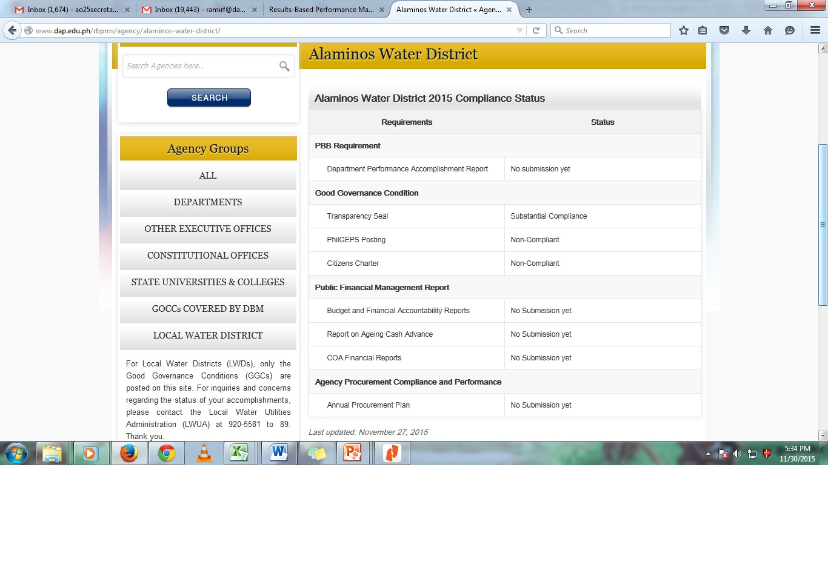

Slide 45
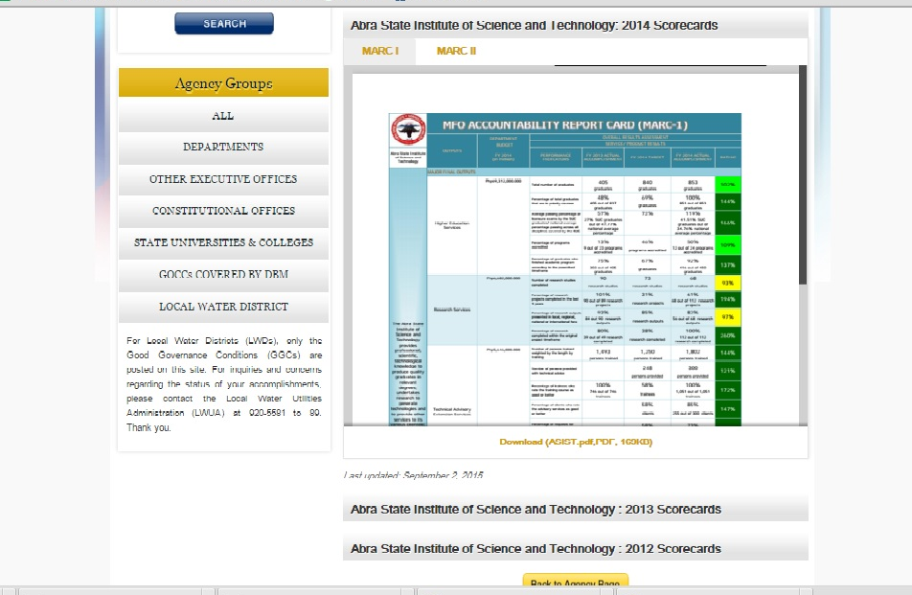

Slide 47
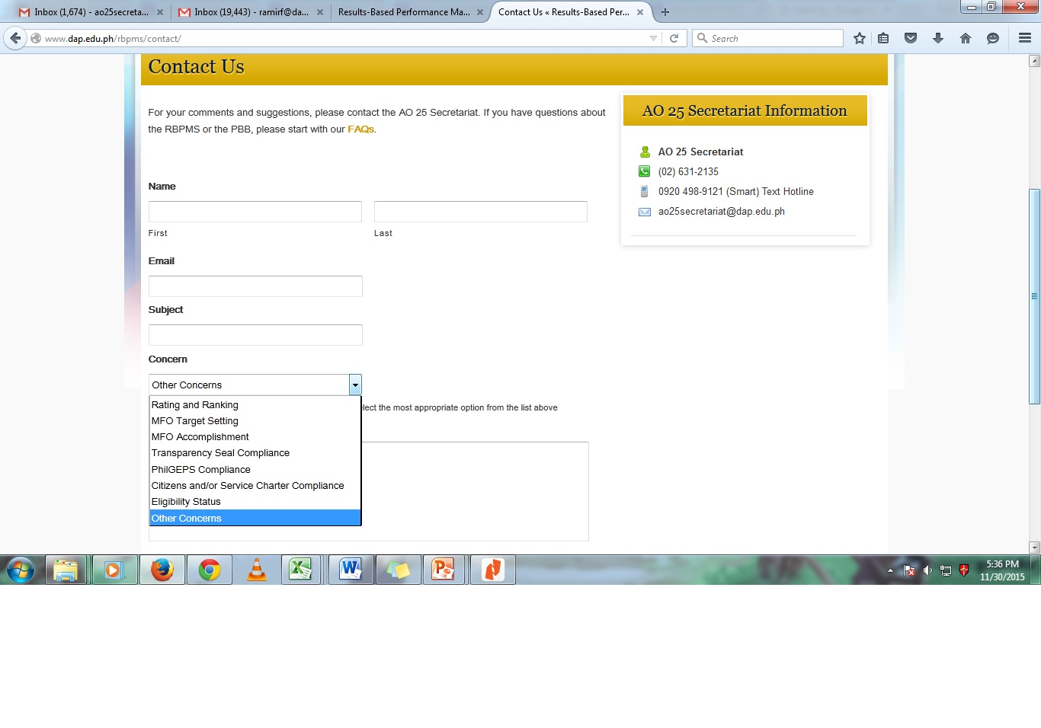

Slide 48
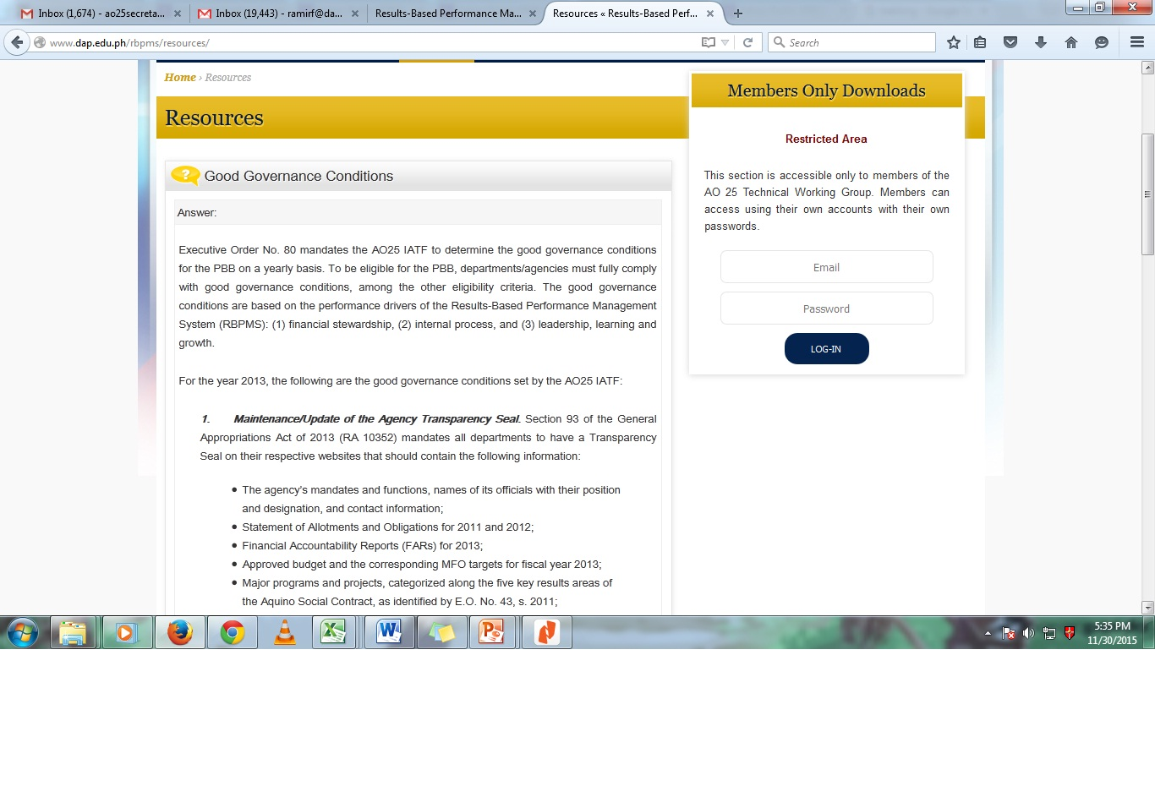

Slide 49
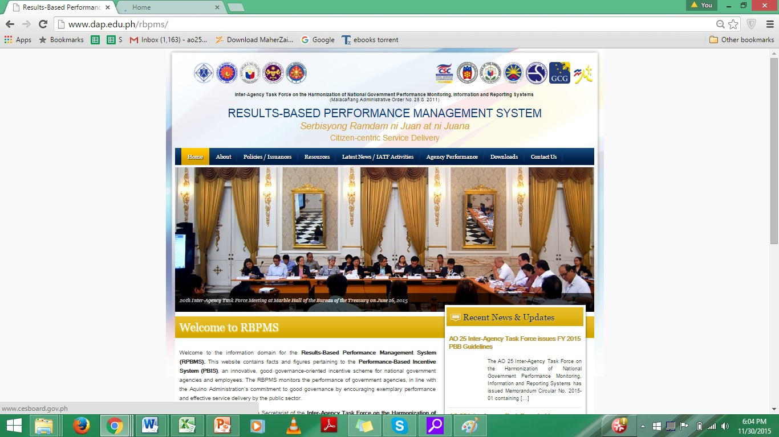
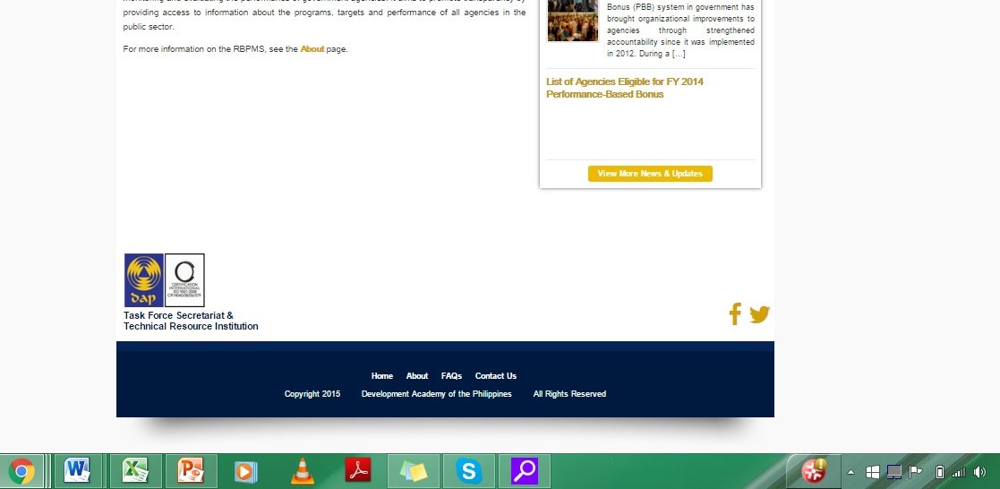

Slide 50
Thank you!

